Slide 1
Unsupervised Learning CO-4 Session-5

Slide 2



AIM
To familiarize students with the concepts of unsupervised machine learning, its difference with supervised machine learning and the use of unsupervised learning, particularly clustering
INSTRUCTIONAL OBJECTIVES
This session is designed to:
Introduction to unsupervised learning
K-means algorithm
Representation of clusters
LEARNING OUTCOMES
At the end of this session, you should be able to:
Supervised learning vs. unsupervised learning
Clustering algorithm
K-means clustering
Common ways to represent clusters

Slide 3
Supervised learning vs. unsupervised learning
Supervised learning: discover patterns in the data that relate data attributes with a target (class) attribute.
These patterns are then utilized to predict the values of the target attribute in future data instances.
Unsupervised learning: The data have no target attribute.
We want to explore the data to find some intrinsic structures in them.

Slide 4
Clustering
Clustering is a technique for finding similarity groups in data, called clusters. I.e.,
it groups data instances that are similar to (near) each other in one cluster and data instances that are very different (far away) from each other into different clusters.
Clustering is often called an unsupervised learning task as no class values denoting an a priori grouping of the data instances are given, which is the case in supervised learning.
Due to historical reasons, clustering is often considered synonymous with unsupervised learning.
In fact, association rule mining is also unsupervised

Slide 5
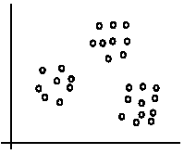
An illustration
The data set has three natural groups of data points, i.e., 3 natural clusters.

Slide 6
What is clustering for?
Let us see some real-life examples
Example 1: groups people of similar sizes together to make “small”, “medium” and “large” T-Shirts.
Tailor-made for each person: too expensive
One-size-fits-all: does not fit all.
Example 2: In marketing, segment customers according to their similarities
To do targeted marketing.

Slide 7
What is clustering for? (cont.…)
Example 3: Given a collection of text documents, we want to organize them according to their content similarities,
To produce a topic hierarchy
In fact, clustering is one of the most utilized machine learning techniques.
It has a long history, and used in almost every field, e.g., medicine, psychology, botany, sociology, biology, archeology, marketing, insurance, libraries, etc.
In recent years, due to the rapid increase of online documents, text clustering becomes important.

Slide 8
Aspects of clustering
A clustering algorithm
Partitional clustering
Hierarchical clustering
…
A distance (similarity, or dissimilarity) function
Clustering quality
Inter-clusters distance ⇒ maximized
Intra-clusters distance ⇒ minimized
The quality of a clustering result depends on the algorithm, the distance function, and the application.

Slide 9

K-means clustering
K-means is a partitional clustering algorithm
Let the set of data points (or instances) D be
{x₁, x₂, …, x_{n}}, where x_{i} = (x_{i1}, x_{i2}, …, x_{ir}) is a vector in a real-valued space X ⊆ R^{r}, and r is the number of attributes (dimensions) in the data.
The k-means algorithm partitions the given data into k clusters.
Each cluster has a cluster center, called centroid.
k is specified by the user

Slide 10
K-means algorithm
Given k, the k-means algorithm works as follows:
Randomly choose k data points (seeds) to be the initial centroids, cluster centers
Assign each data point to the closest centroid
Re-compute the centroids using the current cluster memberships.
If a convergence criterion is not met, go to 2).

Slide 11
K-means algorithm – (cont.…)
Given k, the k-means algorithm works as follows:
Randomly choose k data points (seeds) to be the initial centroids, cluster centers
Assign each data point to the closest centroid
Re-compute the centroids using the current cluster memberships.
If a convergence criterion is not met, go to 2).

Slide 12
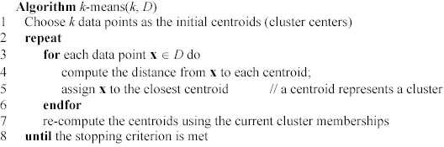
K-means algorithm – (cont.…)

Slide 13
Stopping/convergence criterion
no (or minimum) re-assignments of data points to different clusters
no (or minimum) change of centroids, or
minimum decrease in the sum of squared error (SSE),
C_{i} is the jth cluster, m_{j} is the centroid of cluster C_{j} (the mean vector of all the data points in C_{j}), and dist(x, m_{j}) is the distance between data point x and centroid m_{j}.

Slide 14
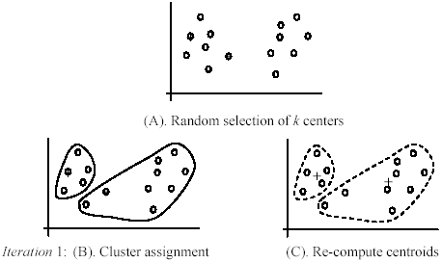
An example

Slide 15
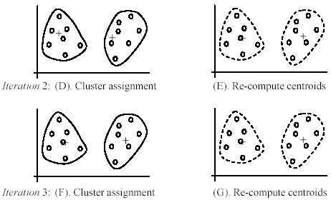
An example (cont.…)

Slide 16
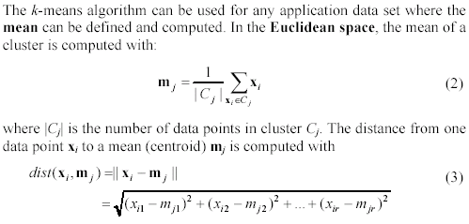
An example distance function

Slide 17
A disk version of k-means
K-means can be implemented with data on disk
In each iteration, it scans the data once.
as the centroids can be computed incrementally
It can be used to cluster large datasets that do not fit in main memory
We need to control the number of iterations
In practice, a limited is set (< 50).
Not the best method. There are other scale-up algorithms, e.g., BIRCH.

Slide 18
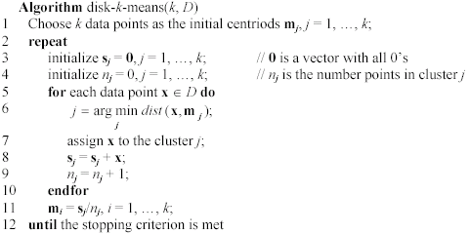
A disk version of k-means (cont …)

Slide 19
Strengths of k-means
Strengths:
Simple: easy to understand and to implement
Efficient: Time complexity: O(tkn), where n is the number of data points, k is the number of clusters, and t is the number of iterations.
Since both k and t are small. k-means is considered a linear algorithm.
K-means is the most popular clustering algorithm.
Note that: it terminates at a local optimum if SSE is used. The global optimum is hard to find due to complexity.

Slide 20
Weaknesses of k-means
The algorithm is only applicable if the mean is defined.
For categorical data, k-mode - the centroid is represented by most frequent values.
The user needs to specify k.
The algorithm is sensitive to outliers
Outliers are data points that are very far away from other data points.
Outliers could be errors in the data recording or some special data points with very different values.

Slide 21
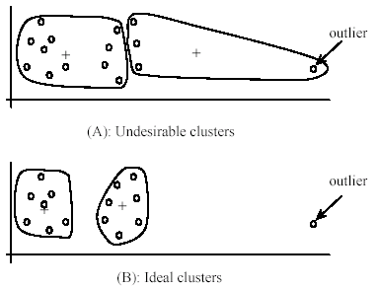
Weaknesses of k-means: Problems with outliers

Slide 22
Weaknesses of k-means: To deal with outliers
One method is to remove some data points in the clustering process that are much further away from the centroids than other data points.
To be safe, we may want to monitor these possible outliers over a few iterations and then decide to remove them.
Another method is to perform random sampling. Since in sampling we only choose a small subset of the data points, the chance of selecting an outlier is very small.
Assign the rest of the data points to the clusters by distance or similarity comparison, or classification

Slide 23
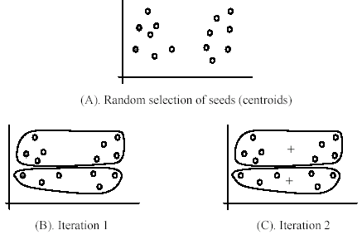
Weaknesses of k-means (cont.…)
The algorithm is sensitive to initial seeds.

Slide 24
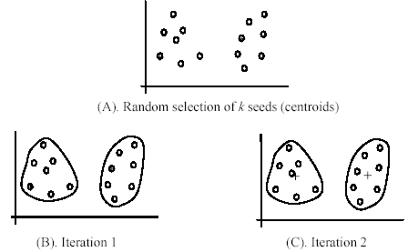
Weaknesses of k-means (cont.…)
If we use different seeds: good results
There are some methods to help choose good seeds

Slide 25
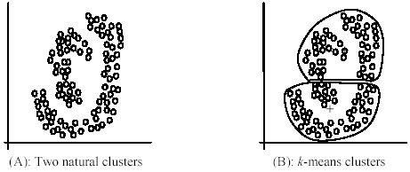
Weaknesses of k-means (cont.…)
The k-means algorithm is not suitable for discovering clusters that are not hyper-ellipsoids (or hyper-spheres).

Slide 26
Common ways to represent clusters
Use the centroid of each cluster to represent the cluster.
compute the radius and
standard deviation of the cluster to determine its spread in each dimension
The centroid representation alone works well if the clusters are of the hyper-spherical shape.
If clusters are elongated or are of other shapes, centroids are not sufficient

Slide 27
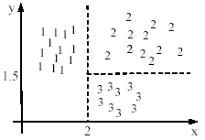

Using classification model
All the data points in a cluster are regarded to have the same class label, e.g., the cluster ID.
run a supervised learning algorithm on the data to find a classification model.

Slide 28
Use frequent values to represent cluster
This method is mainly for clustering of categorical data (e.g., k-modes clustering).
Main method used in text clustering, where a small set of frequent words in each cluster is selected to represent the cluster.

Slide 29
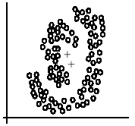
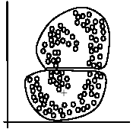
Clusters of arbitrary shapes
Hyper-elliptical and hyper-spherical clusters are usually easy to represent, using their centroid together with spreads.
Irregular shape clusters are hard to represent. They may not be useful in some applications.
Using centroids are not suitable (upper figure) in general
K-means clusters may be more useful (lower figure), e.g., for making 2 size T-shirts.

Slide 30
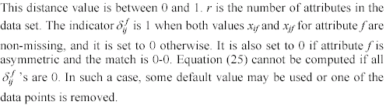
Combining individual distances
This approach computes individual attribute distances and then combine them.

Slide 31
Summary
Clustering is having along history and still active
There are a huge number of clustering algorithms
More are still coming every year.
We only introduced several main algorithms. There are many others, e.g.,
density based algorithm, sub-space clustering, scale-up methods, neural networks-based methods, fuzzy clustering, co-clustering, etc.
Clustering is hard to evaluate, but very useful in practice. This partially explains why there are still many clustering algorithms being devised every year.
Clustering is highly application dependent and to some extent subjective.

Slide 32
Common ways to represent clusters
Use the centroid of each cluster to represent the cluster.
compute the radius and
standard deviation of the cluster to determine its spread in each dimension
The centroid representation alone works well if the clusters are of the hyper-spherical shape.
If clusters are elongated or are of other shapes, centroids are not sufficient

Slide 33
Using classification model
All the data points in a cluster are regarded to have the same class label, e.g., the cluster ID.
run a supervised learning algorithm on the data to find a classification model.

Slide 34
THANK YOU
TEAM ML

